Slide 1
COSC2083 Introduction to IT
Lecture 3: Security

Slide 2
Overview
Introduction
Threats and Vulnerabilities
Attacks
Protection / Controls
Organizational strategies
Q&As

Slide 3
Session 1
Introduction

Slide 4
Short Exercise!
Communication + Topics / Interests in IT
Form a pair with a person nearby
Compare your answers to the question:
“What methods/policies do you have to protect your systems, data, privacy?”
You have a few minutes

Slide 5
Coverage / Discussions
Security in IT
Introduction to Information Security
Unintentional Threats to Information Systems
Deliberate Threats to Information Systems
What Organizations Are Doing to Protect Information Resources
Information Security Controls

Slide 6
Terminology
Security: the degree of protection against criminal activity, danger, damage, and/or loss.
Information Security: all of the processes and policies designed to protect an organization’s information and information systems (IS) from unauthorized access, use, disclosure, disruption, modification, or destruction.

Slide 7
Terminology
Threat (to an information resource): any danger to which a system may be exposed.
Exposure: is the harm, loss, or damage that can result if a threat compromises an information resource.
Vulnerability (of an information resource): is the possibility that the system will be harmed by a threat.

Slide 8
Computer Security
The expression computer security often conjures (remind) up notions that are related to:
confidentiality,
integrity,
availability,
reliability,
safety,
privacy.

Slide 9
The CIA triad
Confidentiality focuses on protecting against unauthorised disclosure of information to third parties.
Integrity can be understood as preventing unauthorised modification of files.
Availability means preventing unauthorised withholding of information from those who need it when they need it.
Notes:
Joseph Kizza (2003) suggests that computer security can be defined in terms of three main elements:
confidentiality;
integrity;
availability.
Three main elements define computer security
Confidentiality focuses on protecting against unauthorized disclosure of information to third parties.
Integrity can be understood as preventing unauthorized modification of files.
Availability means preventing unauthorized withholding of information from those who need it when they need it.

Slide 10
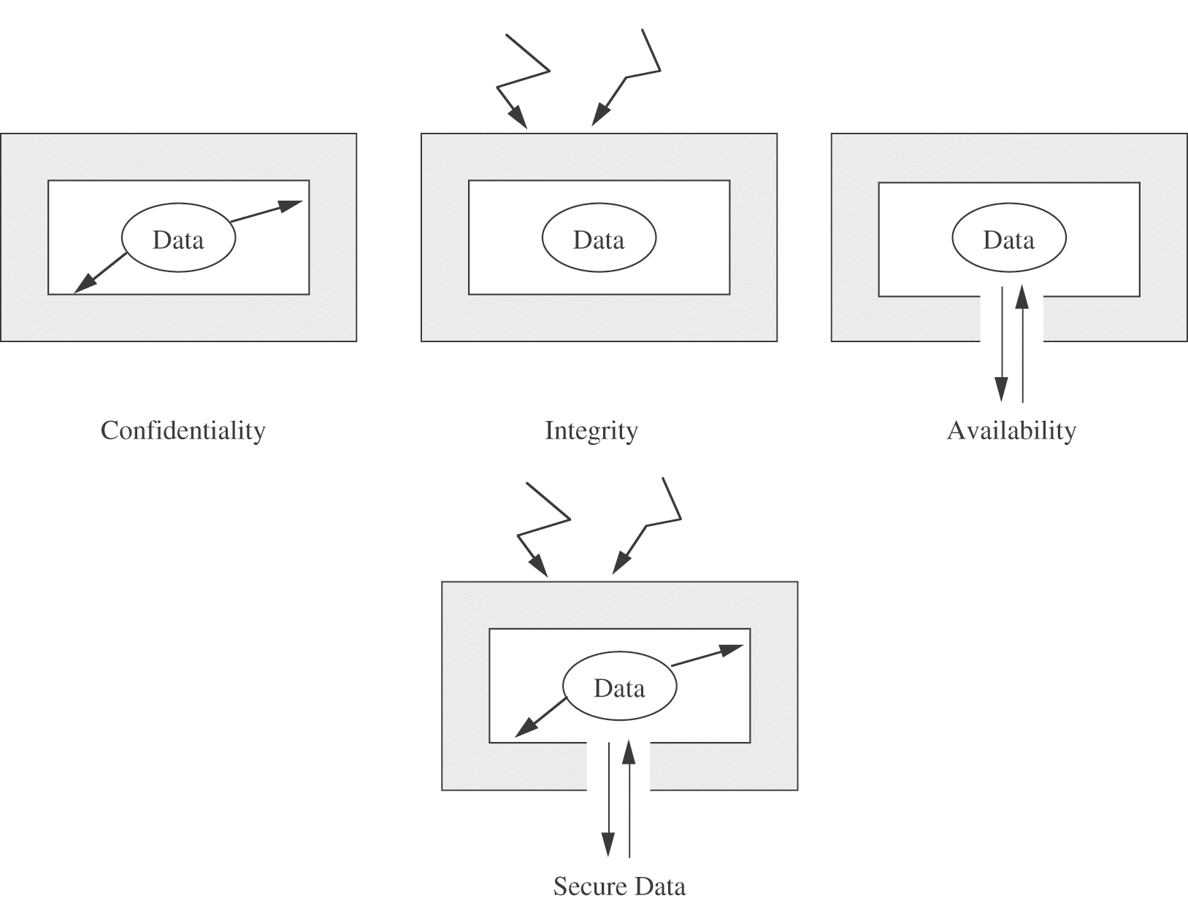
The CIA triad

Slide 11
Computer Security Issues as Distinct from Computer Crime
Computer security issues often overlap with issues analysed under the topic of computer crime.
Virtually every breach or violation of security involving cyber-technology is also criminal in nature.
For example, hacking or sabotage
But not every instance of crime in cyberspace necessarily involves a breach or violation of security.

Slide 12
Computer Security Issues as Distinct from Computer Crime
For example, an individual can use a personal computer to:
make unauthorised copies of software programs;
stalk (follow) a victim in cyberspace;
distribute child pornography;
engage in illegal gambling activities.
None of these kinds of crimes are a direct result of insecure computer systems.

Slide 13
Why study Information Security?
Being an IT expert requires knowledge about IT security
Developing IT systems without considering security will lead to vulnerable IT systems
Global IT infrastructure is vulnerable to cyber attacks
Every employee, regardless of ranks and positions, must be at least aware of information security issues
Information security is a political issue
Often seen as a cost, but saves costs in the long term
Often given low priority in IT industry and IT education
Notes:
Analogy: Building architects must have knowledge about fire safety

Slide 14
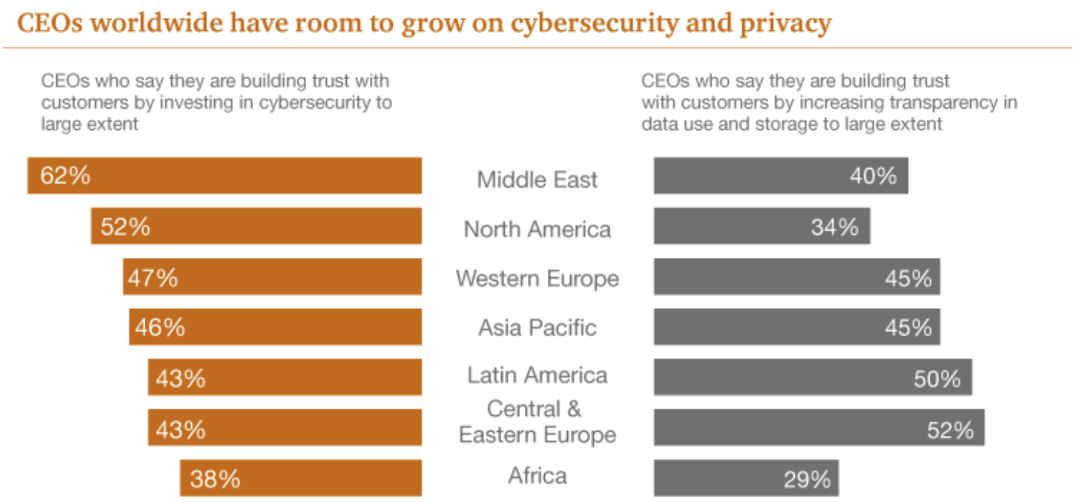
Why study Information Security?
Strategic investment in information security
Source: https://www.pwc.com/us/en/services/consulting/cybersecurity/library/information-security-survey/revitalizing-privacy-trust-in-data-driven-world.html

Slide 15
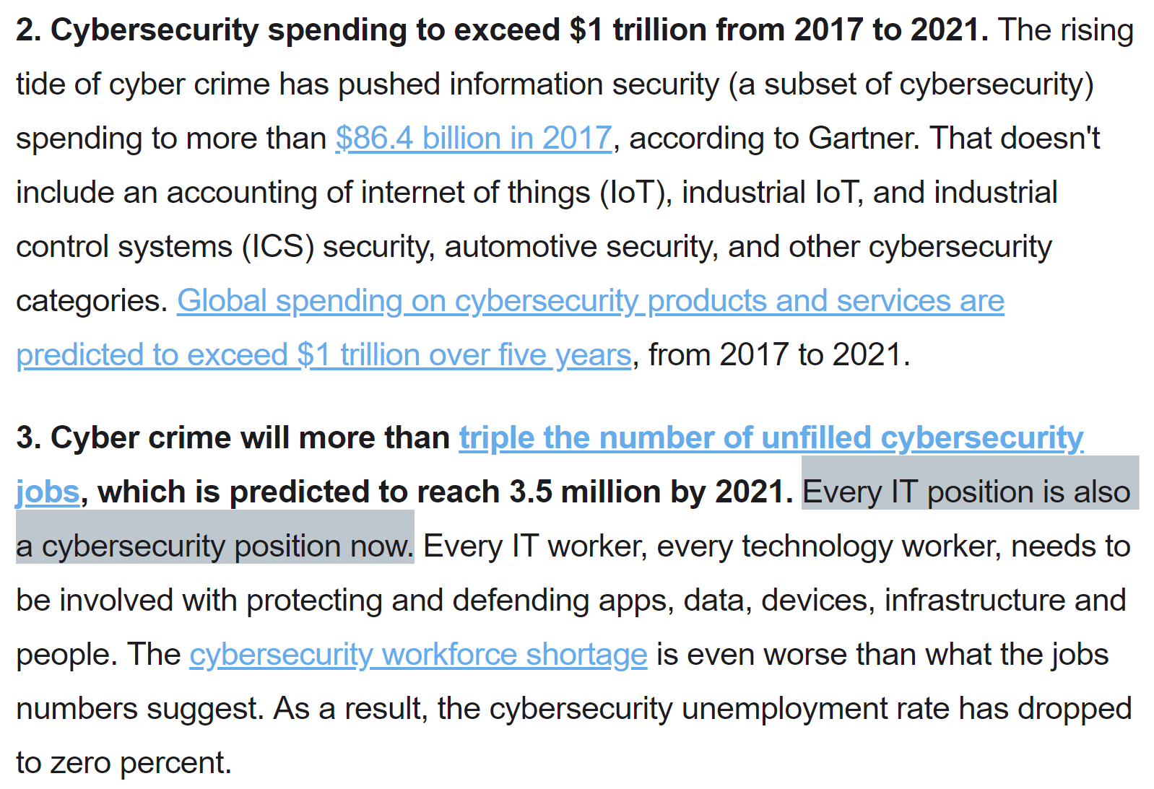
Why study Information Security?
Source: https://www.csoonline.com/article/3153707/security/top-5-cybersecurity-facts-figures-and-statistics.html

Slide 16
Recent Exploits/Breaches/Bugs
Heartbleed [2014]
Shellshock [2014]
Data Exposure
Wikileaks
Tinders lack of encryption (until recently)
Meltdown and Spectre CPU bug | TLBleed
Edward Snowden
A computer professional, and former CIA employee who copied and leaked classified information from the NSA in 2013.
Ashley Madison
~37 Million users caught in this affair (for want of a better word…)
ULCA Health
Had 4.5 Million records stolen, the data was not encrypted.

Slide 17
Security in IT
Threats and Vulnerabilities

Slide 18
Threats – Source of threat?
Where are these threats likely to come from?
Internal
Local Network
External
Remote Network

Slide 19
Threats – Realisation
When are they likely to occur?
When staffing is low
After launch of product or service
After sacking an employee
Context of political situation
As a company or organization grows

Slide 20
Threats – What’s vulnerable?
What’s vulnerable?
Data
Computers
Networks
Knowledge (What your employees know about your organization?)

Slide 21
Threats – What’s the exposure?
What’s the fallout?
Loss of reputation
Loss of income
Legal action

Slide 22
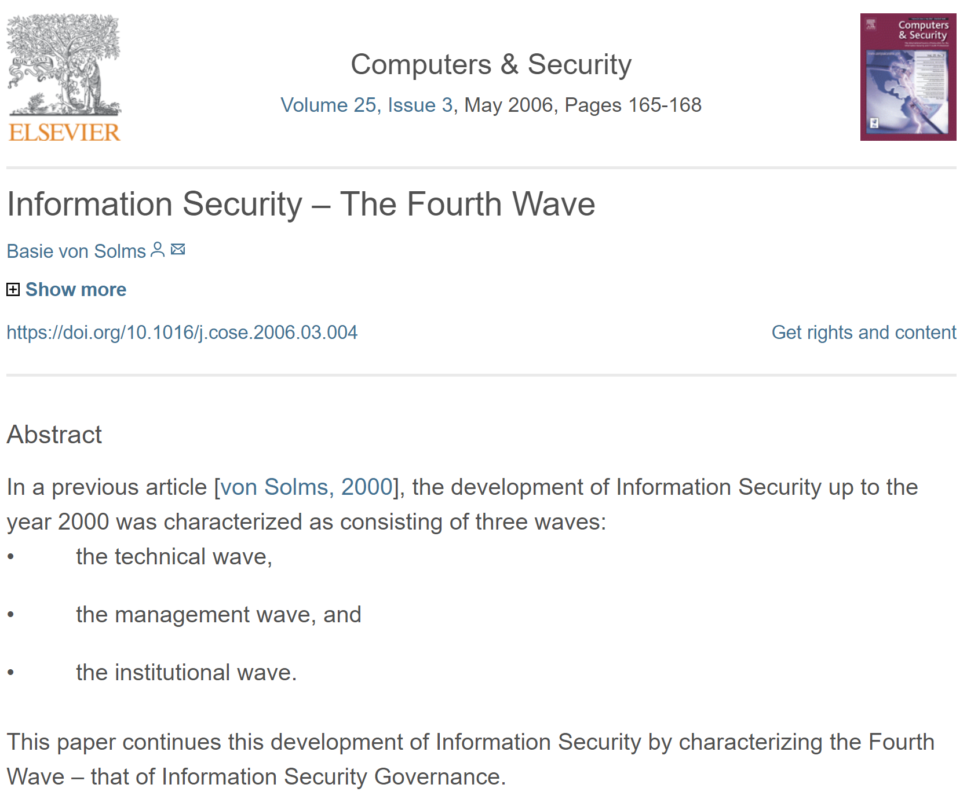
The Fourth Wave of InfoSec

Slide 23
Threats – Who is a threat?
Who pose threats to our systems and data?
Competitors
Clients (Negotiations)
Employees (Current + Former)
Political Activists
Script kiddies (I want to / because I can)

Slide 24
Why are there vulnerabilities (1)
Today’s interconnected, interdependent, wirelessly networked business environment
Lack of awareness and easy attitude towards security issue(s) amongst people
Smaller, faster, cheaper computers & storage devices

Slide 25
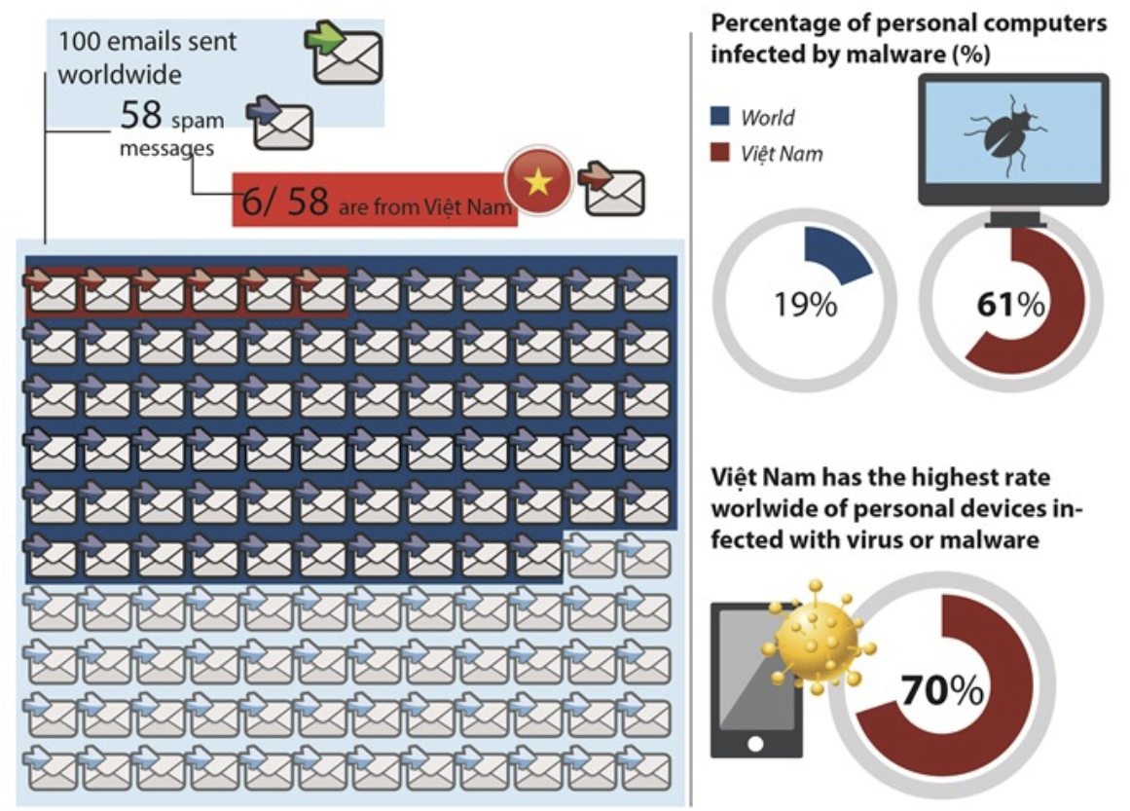
Why are there vulnerabilities (2)
Lack of awareness and easy attitude towards security issue(s) among people
https://cybermap.kaspersky.com/
Source: https://vietnamnews.vn/economy/421963/cyber-security-threat-to-persist-in-2018.html

Slide 26
Why are there vulnerabilities (3)
Decreasing skills necessary to be a computer hacker
International organised crime taking over cybercrime
Team of network admins, intrusion specialists, data miners and financial specialists work together
http://www.cbsnews.com/news/cybercrime-ring-steals-1-2-billion-internet-passwords/
Lack of technical support from organisations

Slide 27
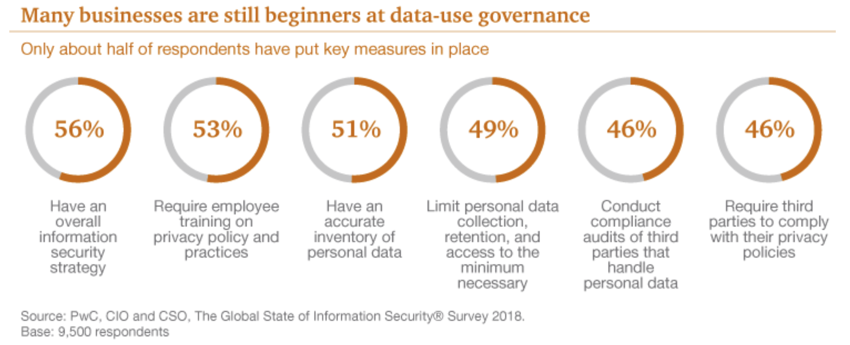
Why are there vulnerabilities (4)
Lack of technical support from organisations
Source: https://www.pwc.com/us/en/services/consulting/cybersecurity/library/information-security-survey/revitalizing-privacy-trust-in-data-driven-world.html

Slide 28
Data, System, & Network Vulnerabilities
Three vulnerabilities:
unauthorized access to data, (i.e., data security);
attacks on system resources (such as computer hardware, operating system software, and application software) by malicious computer programs (i.e., system security);
attacks on computer networks, privately owned networks and the Internet itself (i.e., network security).

Slide 29
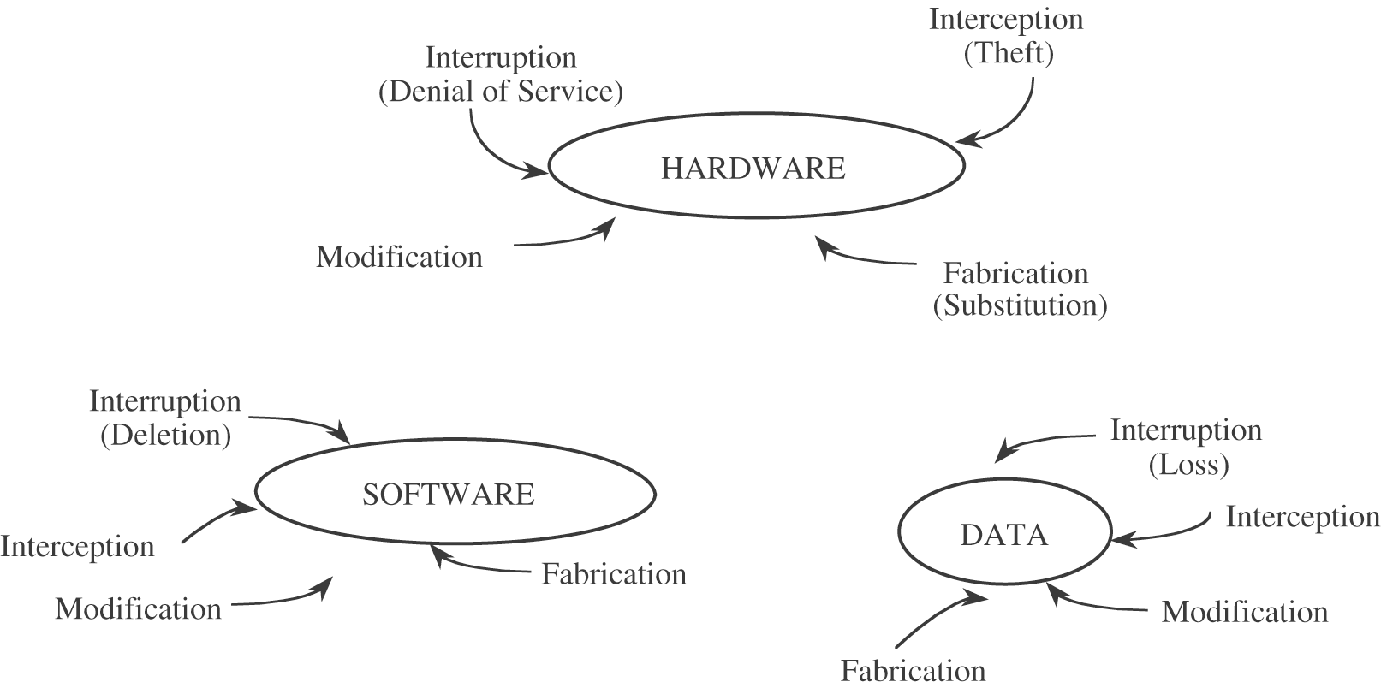
Data, System, & Network Vulnerabilities

Slide 30
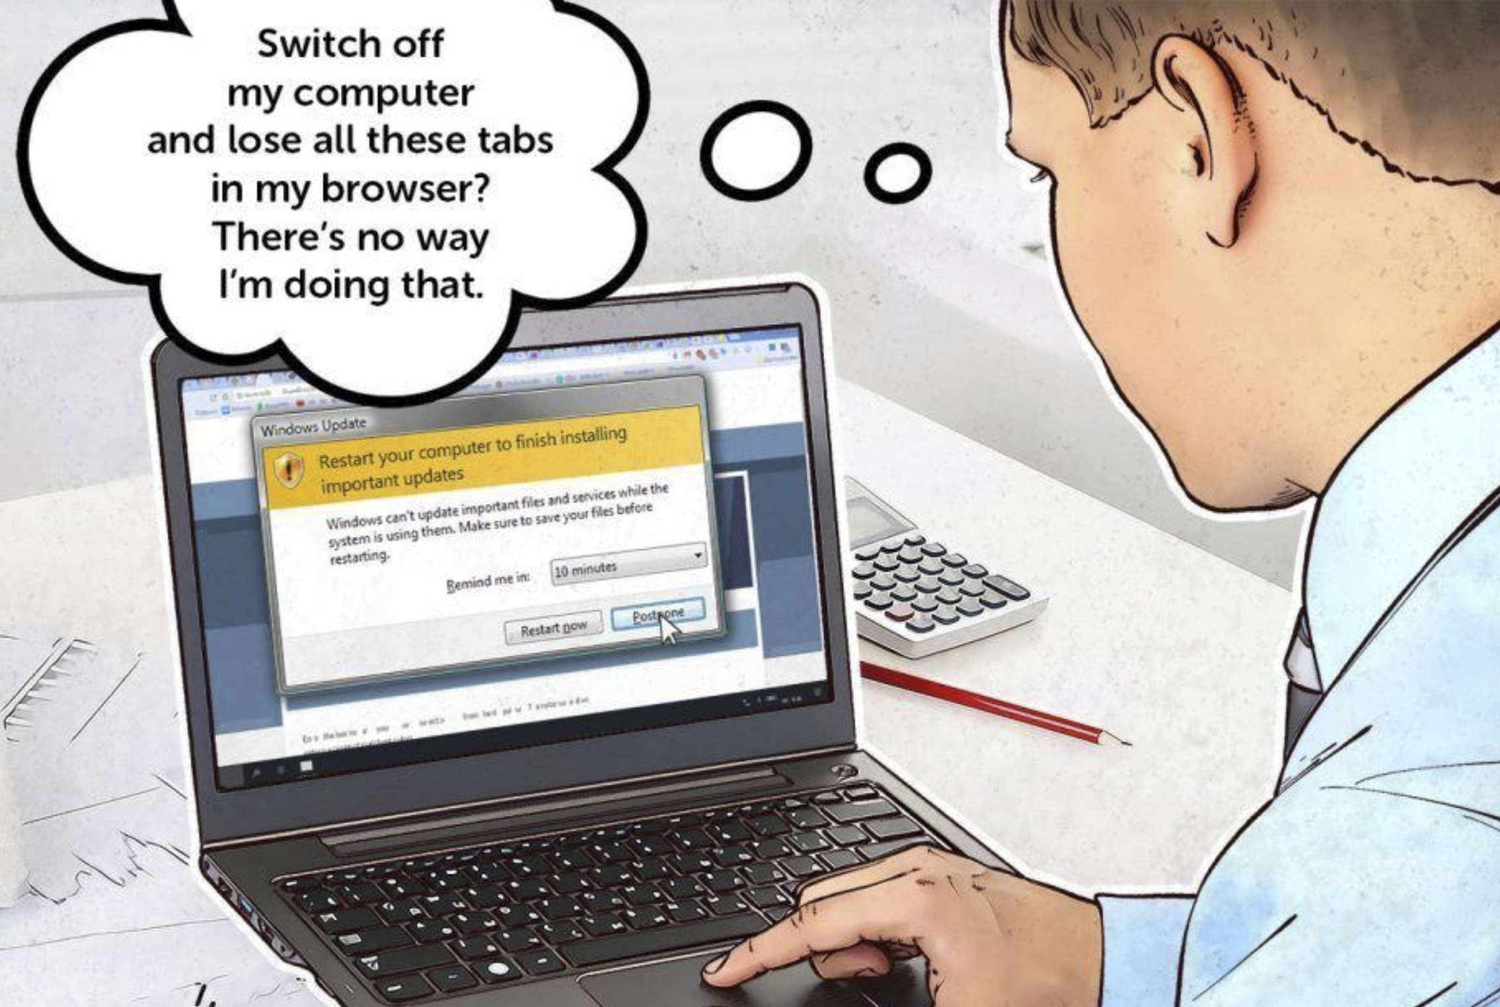
Fourth type of vulnerability?
Human is the weakest link in the information security chain
Source: https://www.kaspersky.com/blog/the-human-factor-in-it-security/

Slide 31
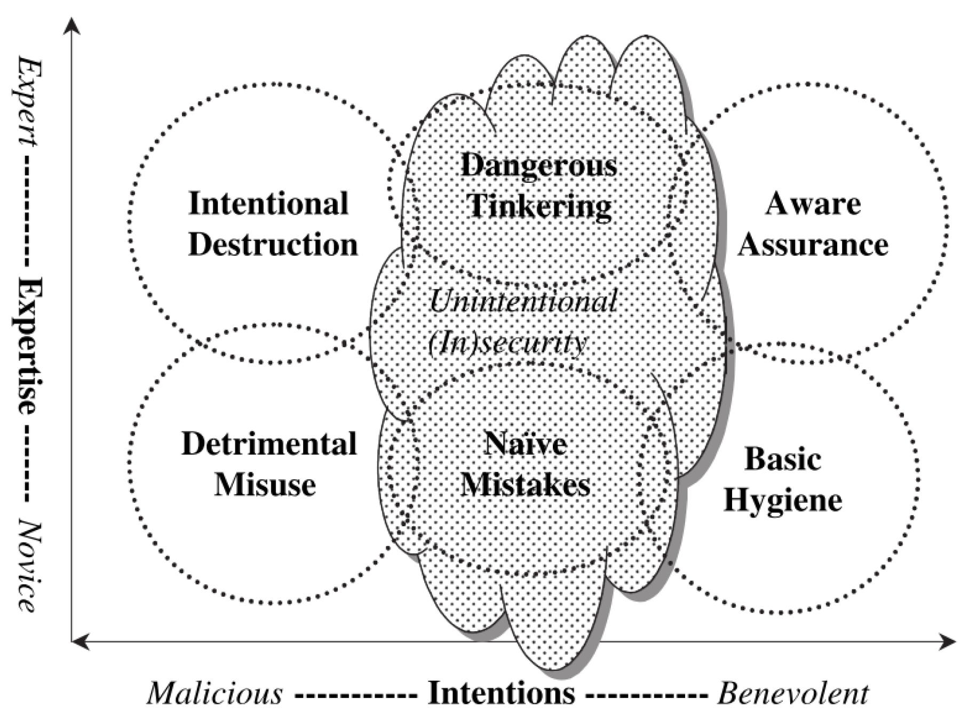
Insider’s Threats
Stanton, JM, Stam, KR, Mastrangelo, P & Jolton, J 2005, ‘Analysis of end user security behaviors’, Computers & Security, vol. 24, no. 2, pp. 124–133.

Slide 32
Common Human Errors (1)
Carelessness with Laptops
Carelessness with Computing Devices
Opening Questionable E-mail
Careless Internet Surfing

Slide 33
Common Human Errors (2)
Poor Password Selection and Use
Carelessness with One’s Office
Carelessness Using Unmanaged Devices

Slide 34
Security in IT
Attacks

Slide 35
Threats + Attacks (1)!
Malware
Virus, Worm, Trojans, Logic Bombs, Ransomware, Adware, Spyware, Rootkits
Password attacks
Brute Force, Dictionary
DOS / DDOS
Denial of Service / Distributed DOS

Slide 36
Threats + Attacks! (2)
Phishing
Deception used to acquire sensitive personal information
Social Engineering
Manipulating people so they give up confidential information
Man-in-the-middle-Attack
Occurs when someone between you and the person with whom you are communicating is actively monitoring, capturing, and controlling your communication transparently.
The list goes on..

Slide 37
Security in IT
Protection / Controls

Slide 38
Counter Measures! (1)
Firewalls
Anti-Virus Software and Antispyware
Encryption Tools
Anonymity Tools

Slide 39
Counter Measures! (2)
Firewall can be defined as:
a system or combination of systems that enforces a boundary between two or more networks.
firewalls serve two purposes in that they control access to all traffic that:
(a) enters an internal network
(b) leaves an internal network.

Slide 40
Counter Measures! (3)
Antispyware programs have become a standard means of protecting against unwanted spyware.
Anonymity - TOR / VPN

Slide 41
Encryption
Encryption is the technique used to convert the information in a message composed in ordinary text (plain text), into cyphers.
The party receiving the encrypted message uses a "key" to decrypt the ciphertext back into plain text.
So long as both parties have the appropriate key, they can decode a message back into its original form (i.e., plain text).

Slide 42
Encryption - Keys / Key Share
One challenge in ensuring the integrity of encrypted communications has been to make sure that the key, which must remain private, can be successfully communicated.
In private-key encryption, both parties use the same encryption algorithm and the same private key.
Public cryptography uses two keys: one public and the other private.
Watch the video: Key Exchange

Slide 43
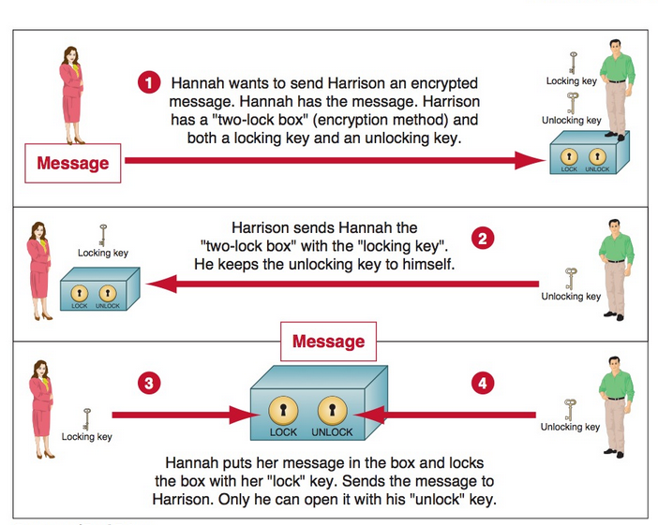
Encryption Tools

Slide 44
Information Security Controls (1)
Physical Controls - Prevent unauthorized individuals from gaining access to a company’s facilities.
Walls / Doors / Locks / Guards / Alarm systems
Access Controls - Authentication and Authorisation

Slide 45
Information Security Controls (2)
Communication Controls
Firewalls
Anti-malware Systems
Whitelisting and Blacklisting
Encryption
Virtual Private Networking
Secure Socket Layer
Employee Monitoring Systems

Slide 46
Security in IT
Organizational strategies

Slide 47
Total Security in Cyberspace
Can total security in organisations be achieved?
If so, would it be a desirable goal?

Slide 48
Total Security in Cyberspace
When asked if we would prefer a secure cyberspace, we would likely answer "yes."
But we might not be willing to accept the consequences of such a level of security.
More secure systems might require certain additional features in cybertechnology
This would result in computer systems being less friendly and thus more difficult for ordinary users to operate.

Slide 49
Tradeoffs Involving Computer Security
More secure computer systems might also result in products that are more expensive.
Would consumers be willing to spend more money for more secure computer systems?
The costs associated with computer security can be measured both in monetary and non-monetary terms (such as convenience and flexibility) because more secure systems might also be less user-friendly.

Slide 50
Information Security Governance
Information security governance consists of the leadership, organisational structures and processes that safeguard information.
Critical to the success of these structures and processes is effective communication amongst all parties based on constructive relationships, a common language and shared commitment to addressing the issues.
Here we focus on Risk Management

Slide 51
InfoSec Risk Management
Organisations perform risk analyses to ensure that their IS security programs are cost effective:
Risk analysis: assessing the value of each risk and estimating the effect
Risk mitigation: take steps to control and contain risks
Risk acceptance: accept the potential risk, continue operating with no controls, and absorb any damages that occur

Slide 52
InfoSec Risk Management
Risk limitation: limit the risk by implementing controls that minimize the impact of the threat.
Risk transference: transfer the risk by using other means to compensate for the loss, such as by purchasing insurance.

Slide 53
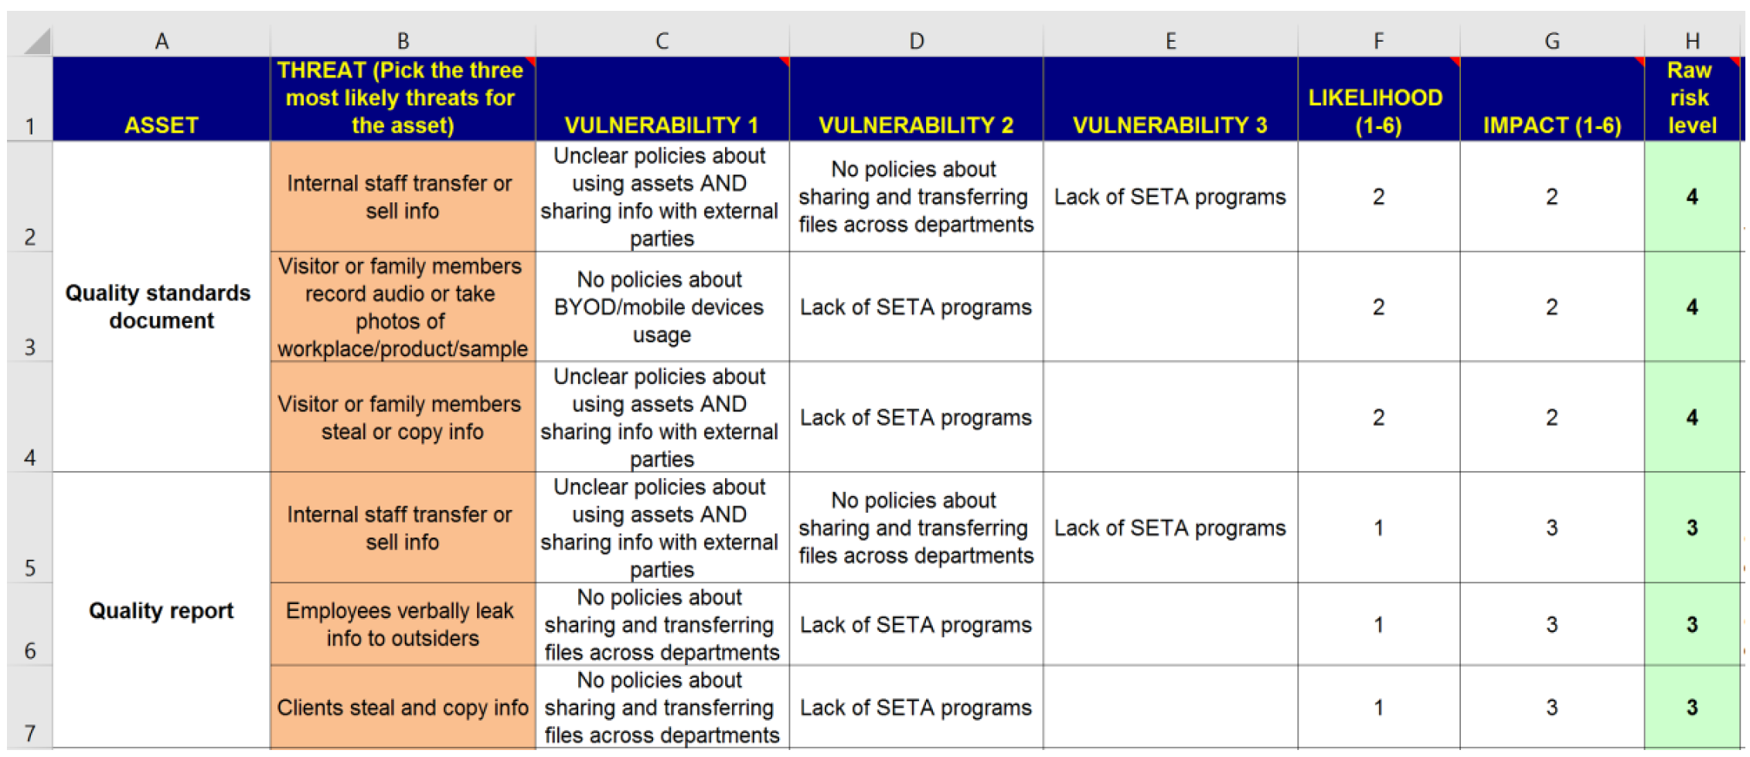
InfoSec Risk Management

Slide 54
Business Continuity Plans
Business continuity plan: refers to the processes that stakeholders take to ensure that normal business operations can continue during a disaster.
Successful continuity plans typically involve making sure that network connections, online systems, phones, network drives, servers, and business applications are allowed to run without downtime.

Slide 55
Disaster Recovery Plans
Disaster recovery plan: unlike business continuity, which is business-centric, disaster recovery is data-centric.
It involve restoring IT infrastructure and accessing copies of data stored offsite without really focusing on making a business operational during a crisis.
Includes hot, warm and cold sites

Slide 56
Disaster Recovery Plans
Hot site: is a fully configured computer facility, with all services, communications links, and physical plant operations.
A hot site duplicates computing resources, peripherals, telephone systems, applications, and workstations.
Regular and real time synchronisation between the actual workplace and hot site is required to completely back up data.

Slide 57
Disaster Recovery Plans
Warm site: same as hot site except it typically does not include the actual applications the company needs. A warm site includes computing equipment such as servers, but it often does not include user workstations. It may have partially backed up data.
Cold site: a secondary workplace with no applications and facilities. It does not include backed up data and is the least expensive option.

Slide 58
Security in IT
Resources

Slide 59
Extra Resources (1)
Watch these videos:
Linus Tech Tips / TechQuickie - As Fast As Possible
Tom Scott
Computerphile
Numberphile
Intricity 101
MKBHD

Slide 60
Extra Resources (2)
Please find a good amount of the resources here:
http://zero.webappsecurity.com/
http://demo.testfire.net/
http://testphp.vulnweb.com/
http://testasp.acunetix.com/
http://testaspnet.acunetix.com/
http://www.enigmagroup.org/
http://www.hacmegame.org/hacmegame/main/ welcome.html
https://www.owasp.org/index.php/OWASP_Hack ademic_Challenges_Project
http://www.nottrusted.com/x5s/
http://overthewire.org/wargames/
https://www.hackthis.co.uk/
http://www.gameofhacks.com/

Slide 61
Extra Resources (3)
Offline Vulnerable Applications
https://www.owasp.org/index.php/OWASP_Broke
http://www.bonsai-sec.com/en/research/moth.p
https://www.mavensecurity.com/web_security_d
https://www.owasp.org/index.php/Category:OW
https://github.com/quantumfoam/DVNA/
http://www.dvwa.co.uk/
http://dvws.secureideas.net/
https://github.com/snoopysecurity/dvws
https://github.com/secvulture/dvta
http://www.badstore.net
http://www.mcafee.com/us/downloads/free-tool s/hacme-bank.aspx/
http://www.mcafee.com/us/downloads/free-tools/ha

Slide 62
Extra Resources (4)
Watch these video:
http://www.mcafee.com/us/downloads/free-tools/ha cmebooks.aspx
http://www.mcafee.com/us/downloads/free-tools/ha cmeshipping.aspx
http://www.mcafee.com/us/downloads/free-tools/ha cmetravel.aspx
http://www.bonsai-sec.com/en/research/moth.php
http://suif.stanford.edu/~livshits/securibench/
https://sourceforge.net/projects/vicnum/
https://google-gruyere.appspot.com/part1
https://code.google.com/p/bodgeit/
http://thebutterflytmp.sourceforge.net/
https://sourceforge.net/projects/exploitcoilvuln/

Slide 63
Goals for this week/next
Verify Groups in class for A2! [Go to your tutorials]
Continue work on Assignment 1
Get excited for IT!

